Slide 1

Thankyou to BECEP for helping Midland Road Nursery School and Children’s Centre a better place!
Jane Robinson worked with groups of parents and children planting herbs and fruit bushes in our new planters at the end of Bateman St.
Hopefully these will be enjoyed not just by our children and parents but the whole community and the many thousand of football supporters who visit Valley Parade!

Slide 2
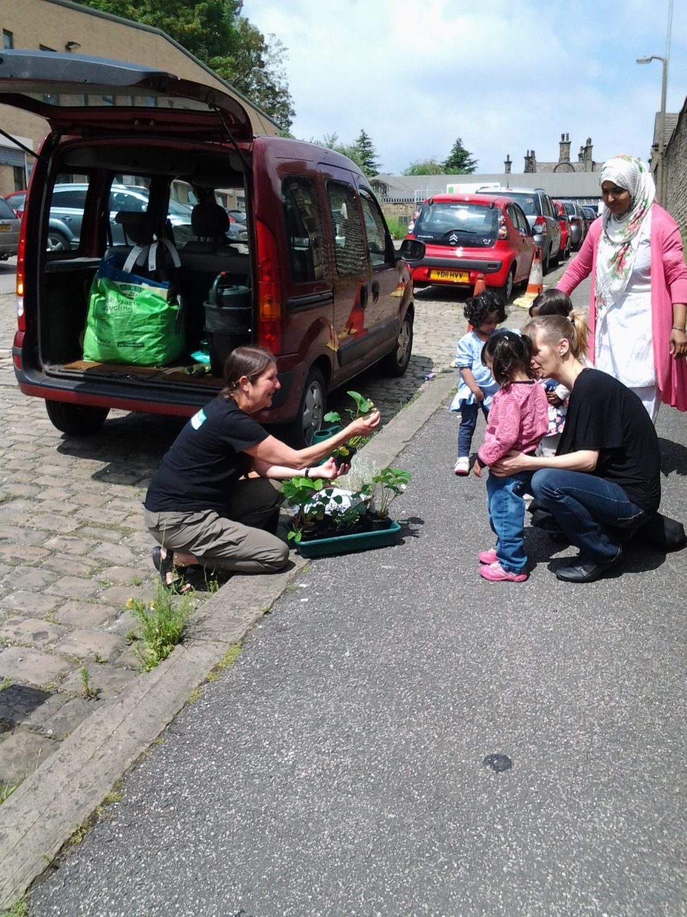

Slide 3
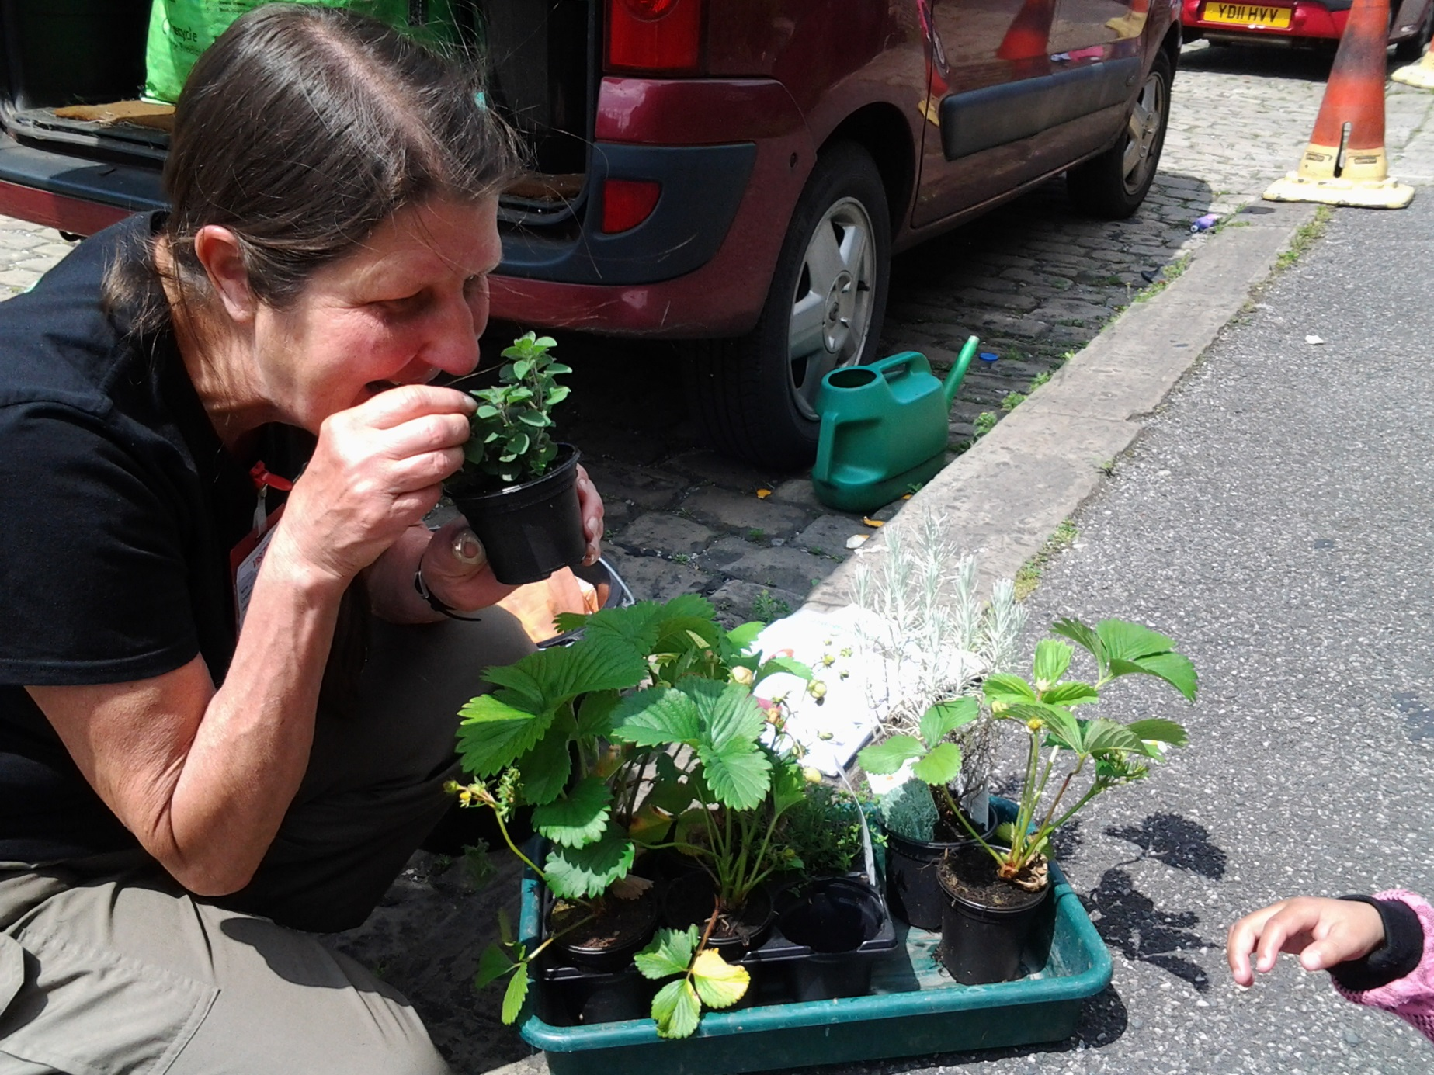

Slide 4
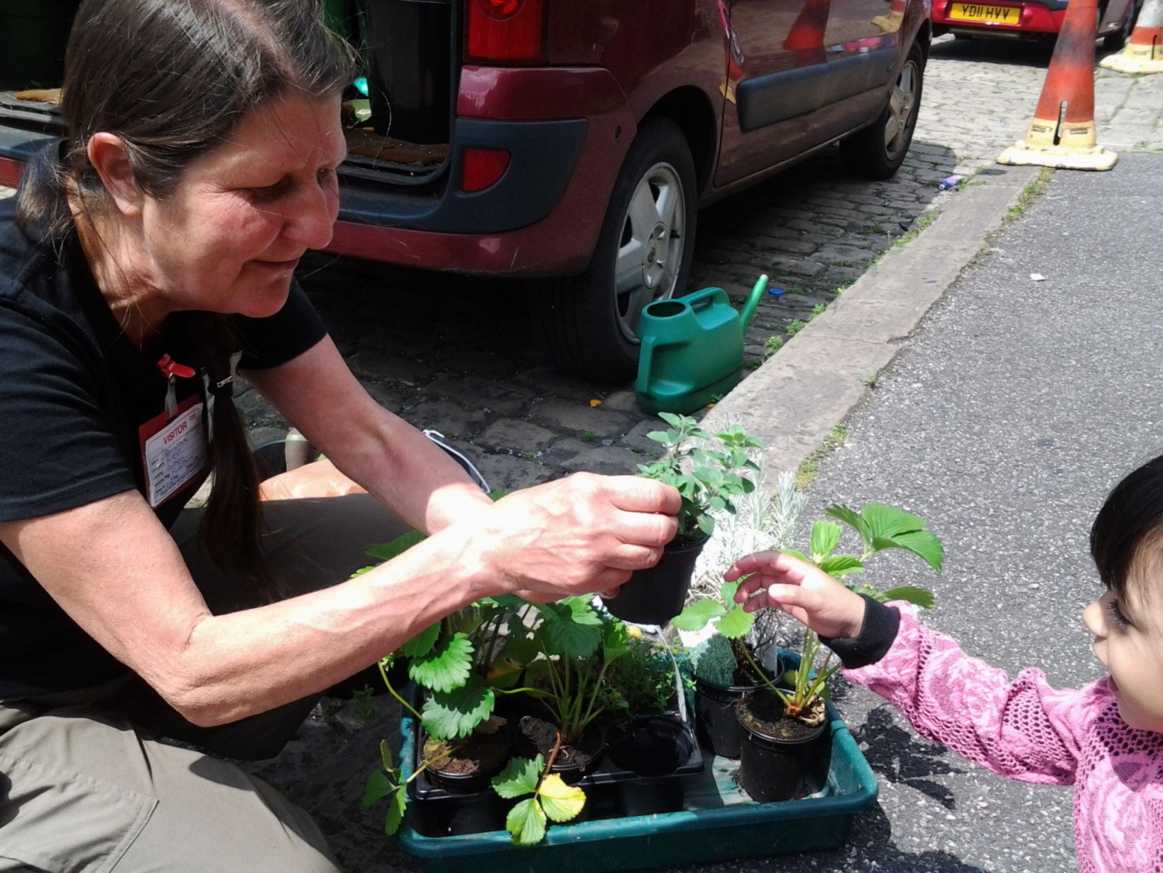

Slide 5
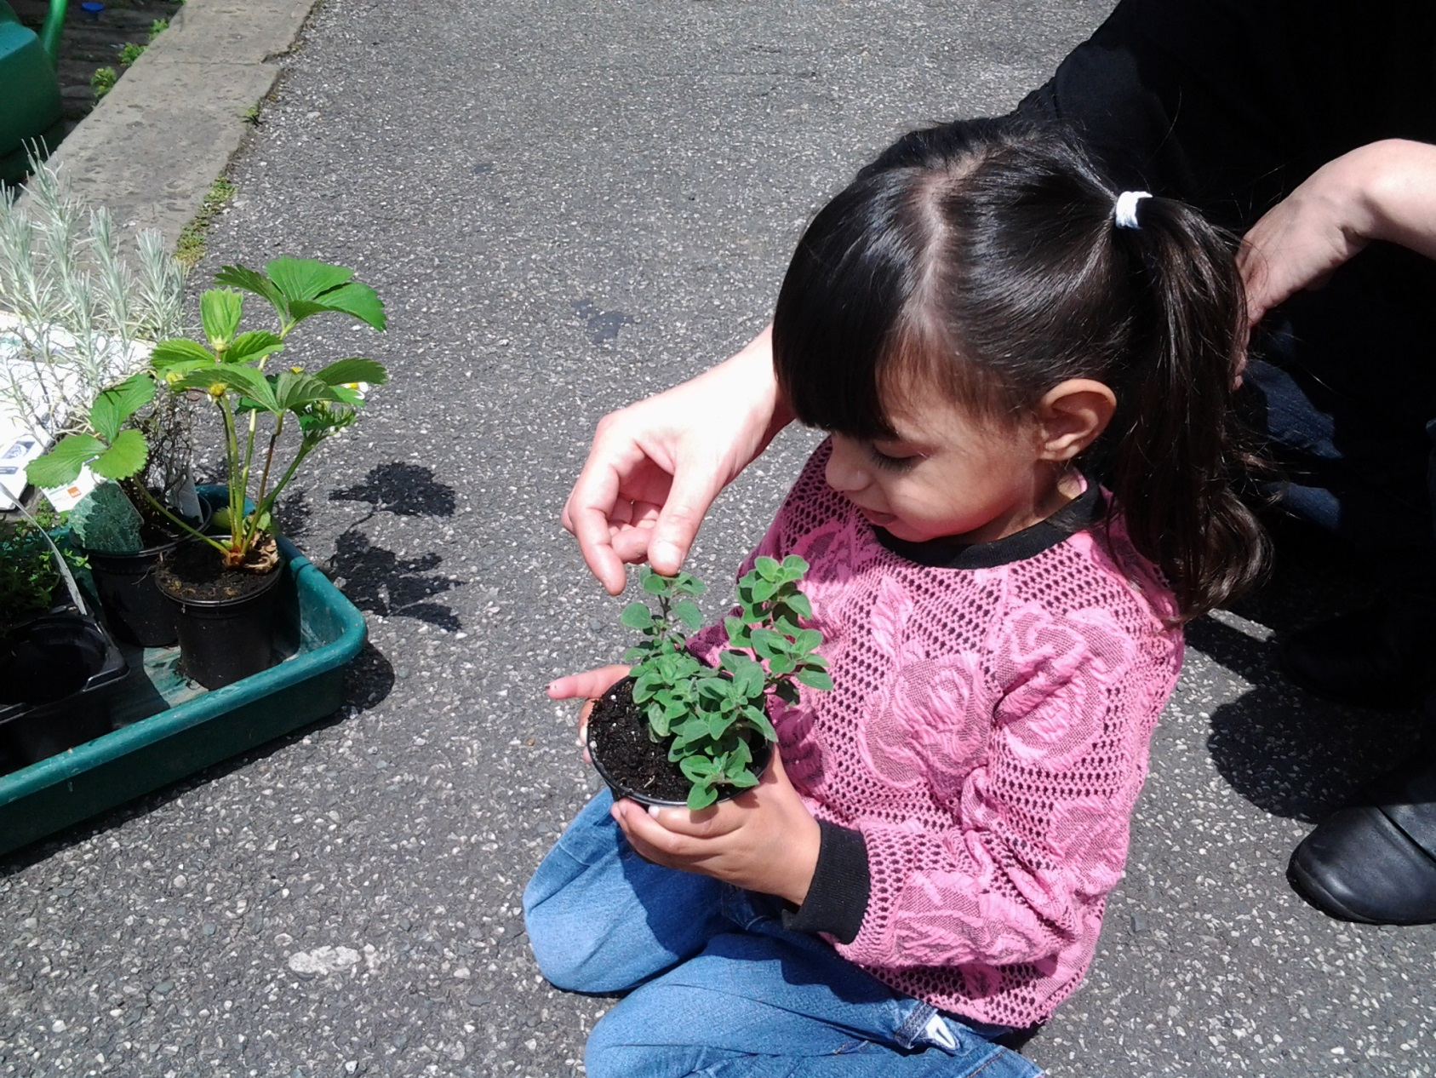

Slide 6
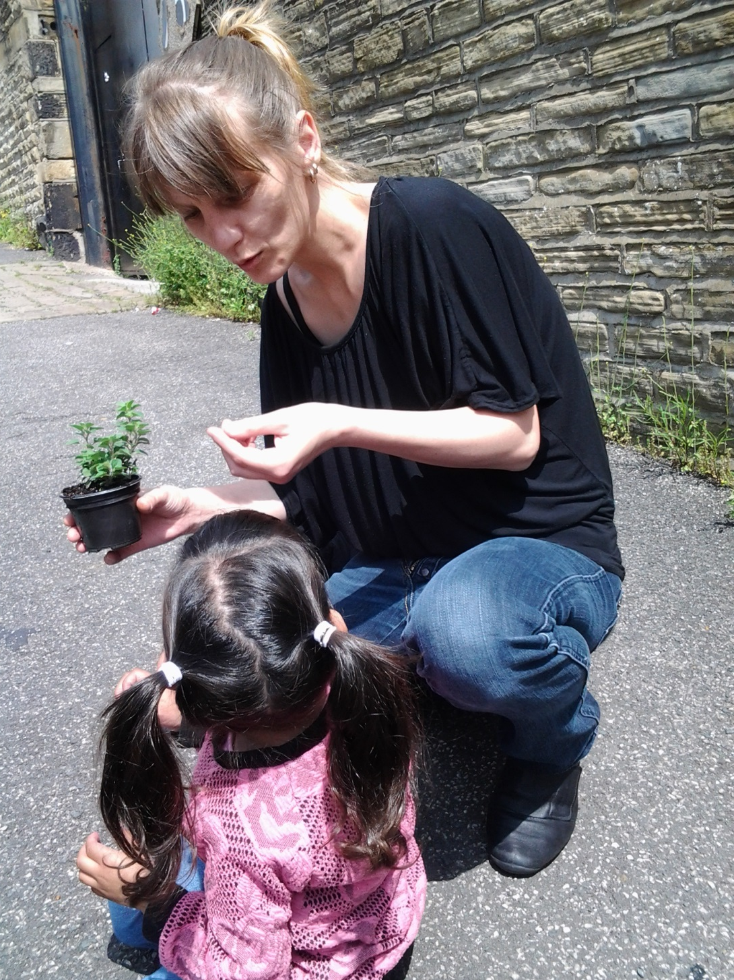

Slide 7
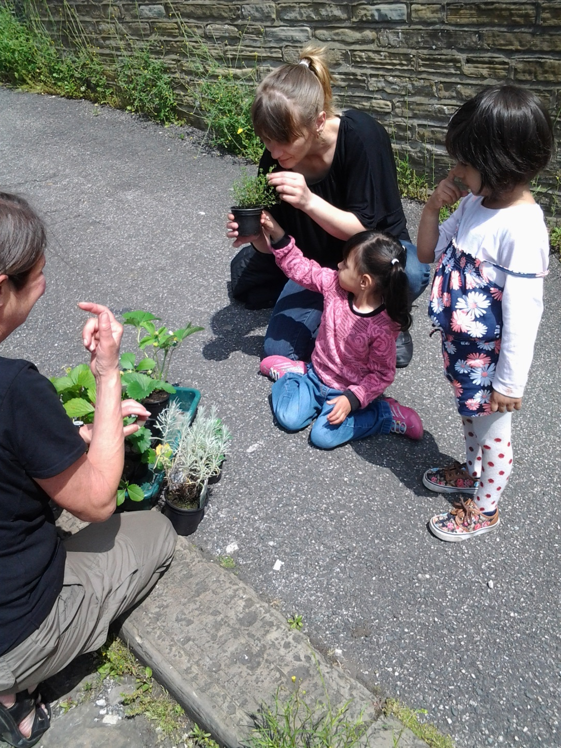

Slide 8
Thankyou to BECEP for helping Midland Road Nursery School and Children’s Centre a better place!
Jane Robinson worked with groups of parents and children planting herbs and fruit bushes in our new planters at the end of Bateman St.
Hopefully these will be enjoyed not just by our children and parents but the whole community and the many thousand of football supporters who visit Valley Parade!

Slide 9
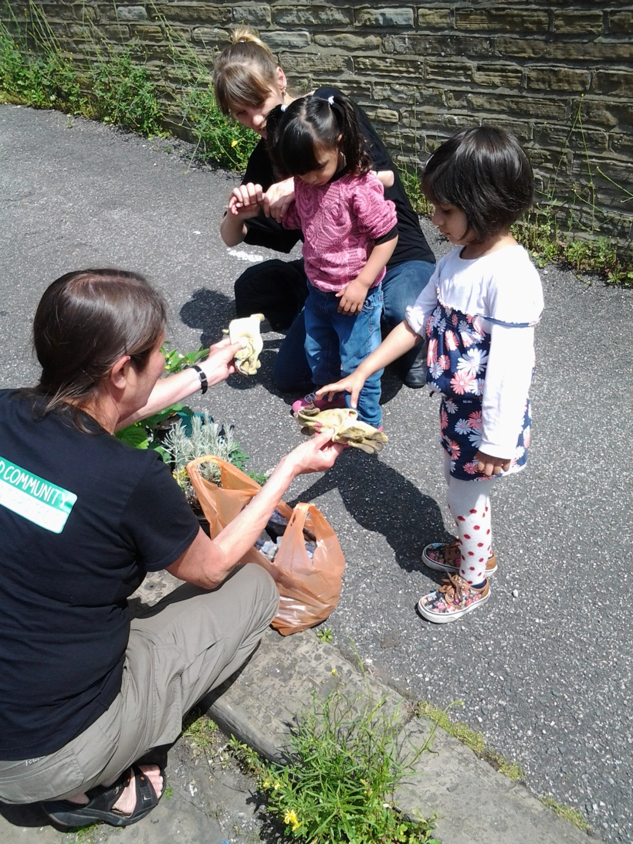

Slide 10
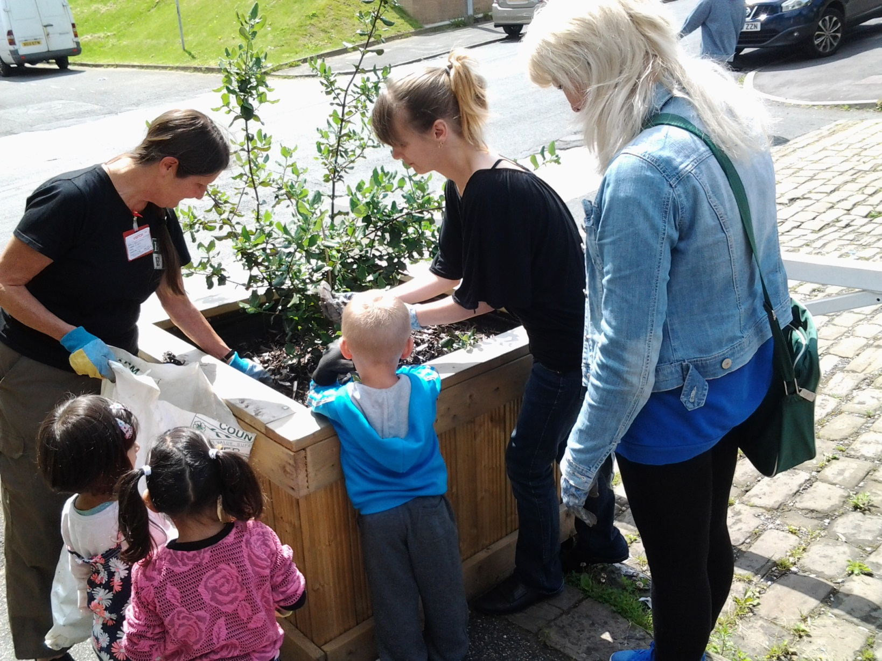

Slide 11
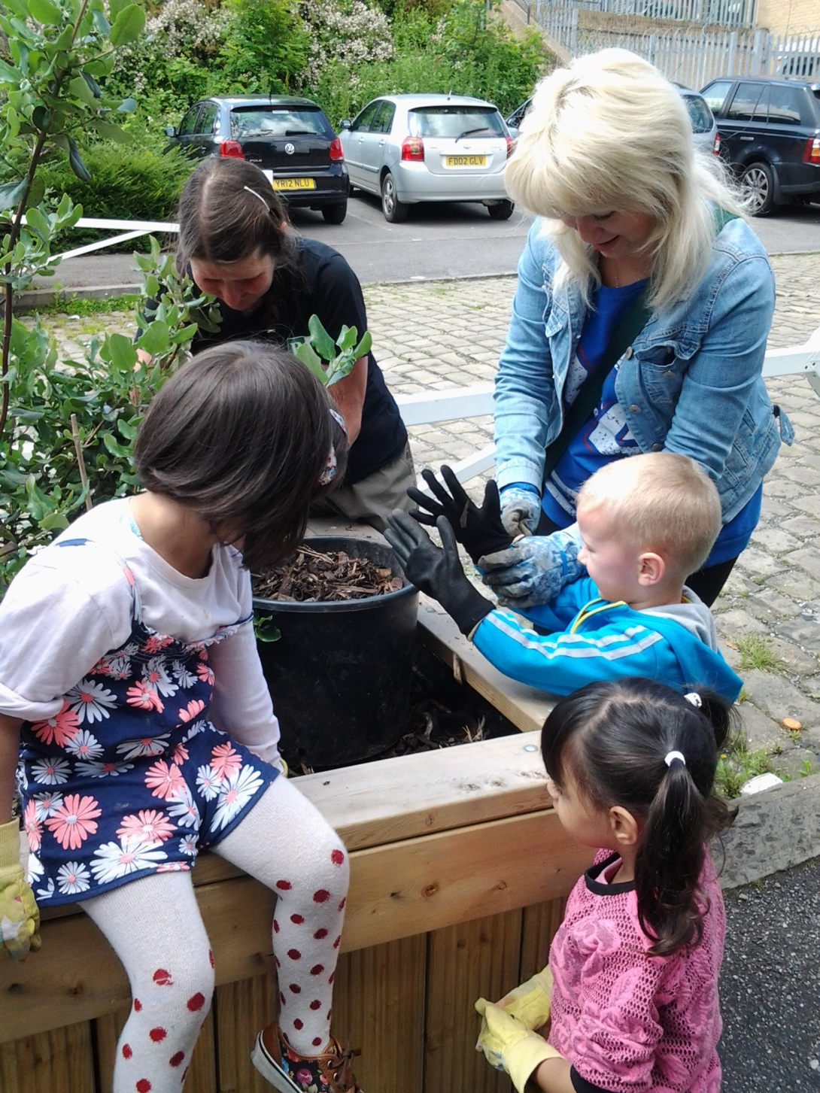

Slide 12
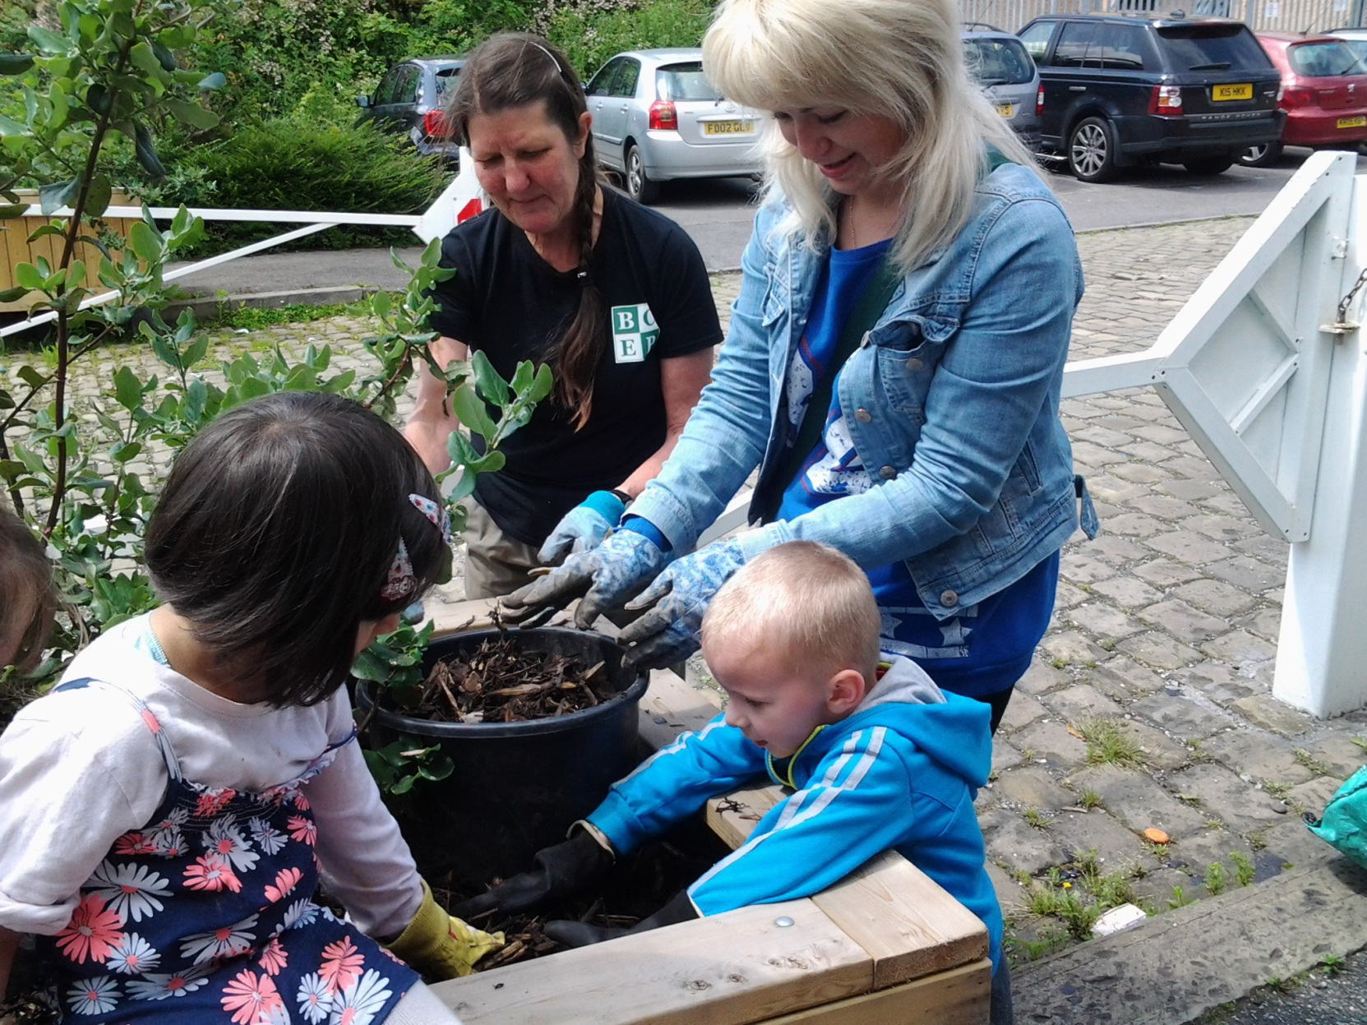

Slide 13
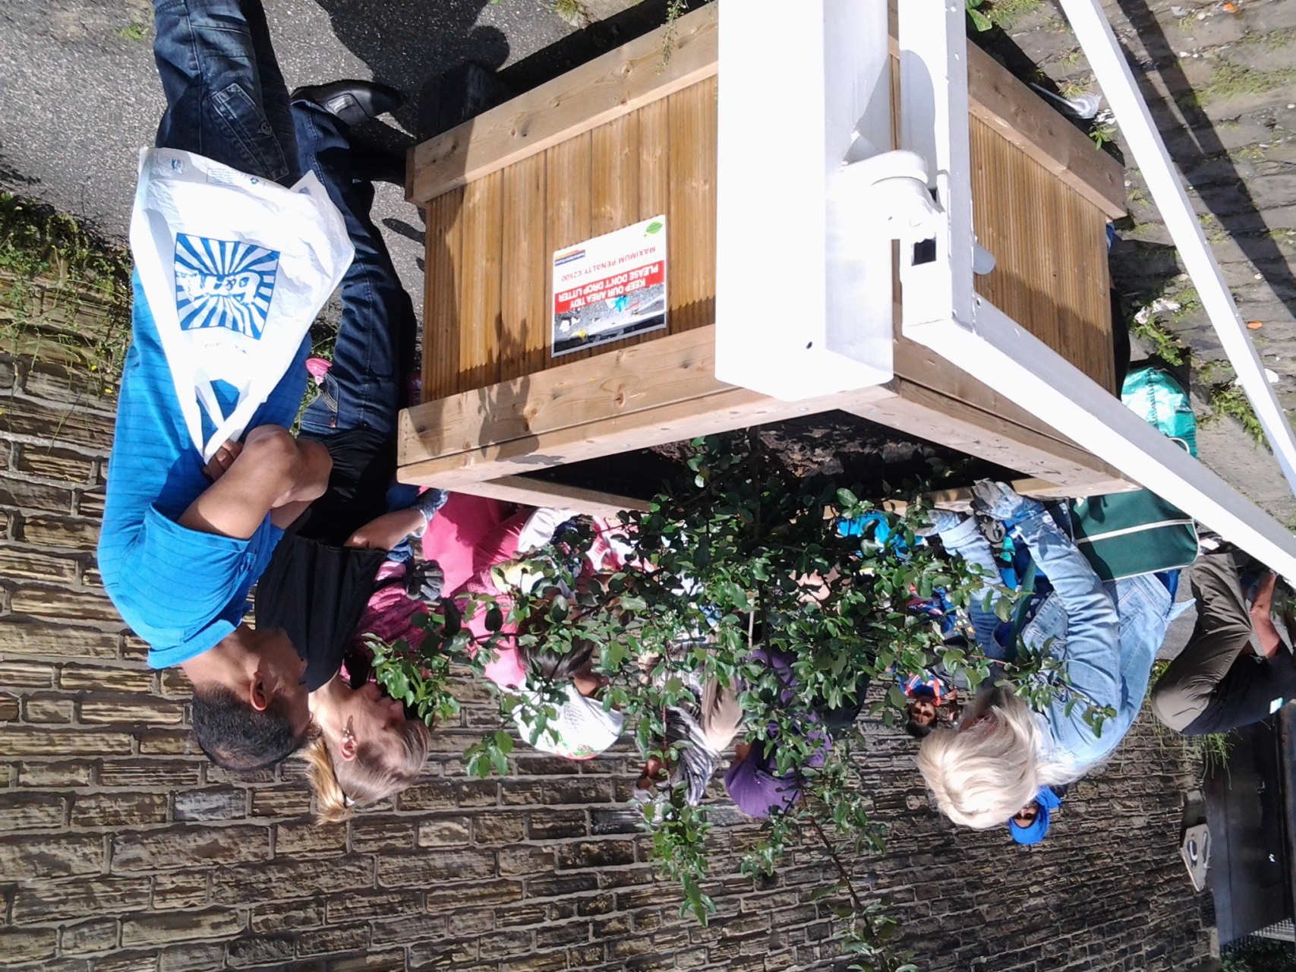

Slide 14
Thankyou to BECEP for helping Midland Road Nursery School and Children’s Centre a better place!
Jane Robinson worked with groups of parents and children planting herbs and fruit bushes in our new planters at the end of Bateman St.
Hopefully these will be enjoyed not just by our children and parents but the whole community and the many thousand of football supporters who visit Valley Parade!

Slide 15
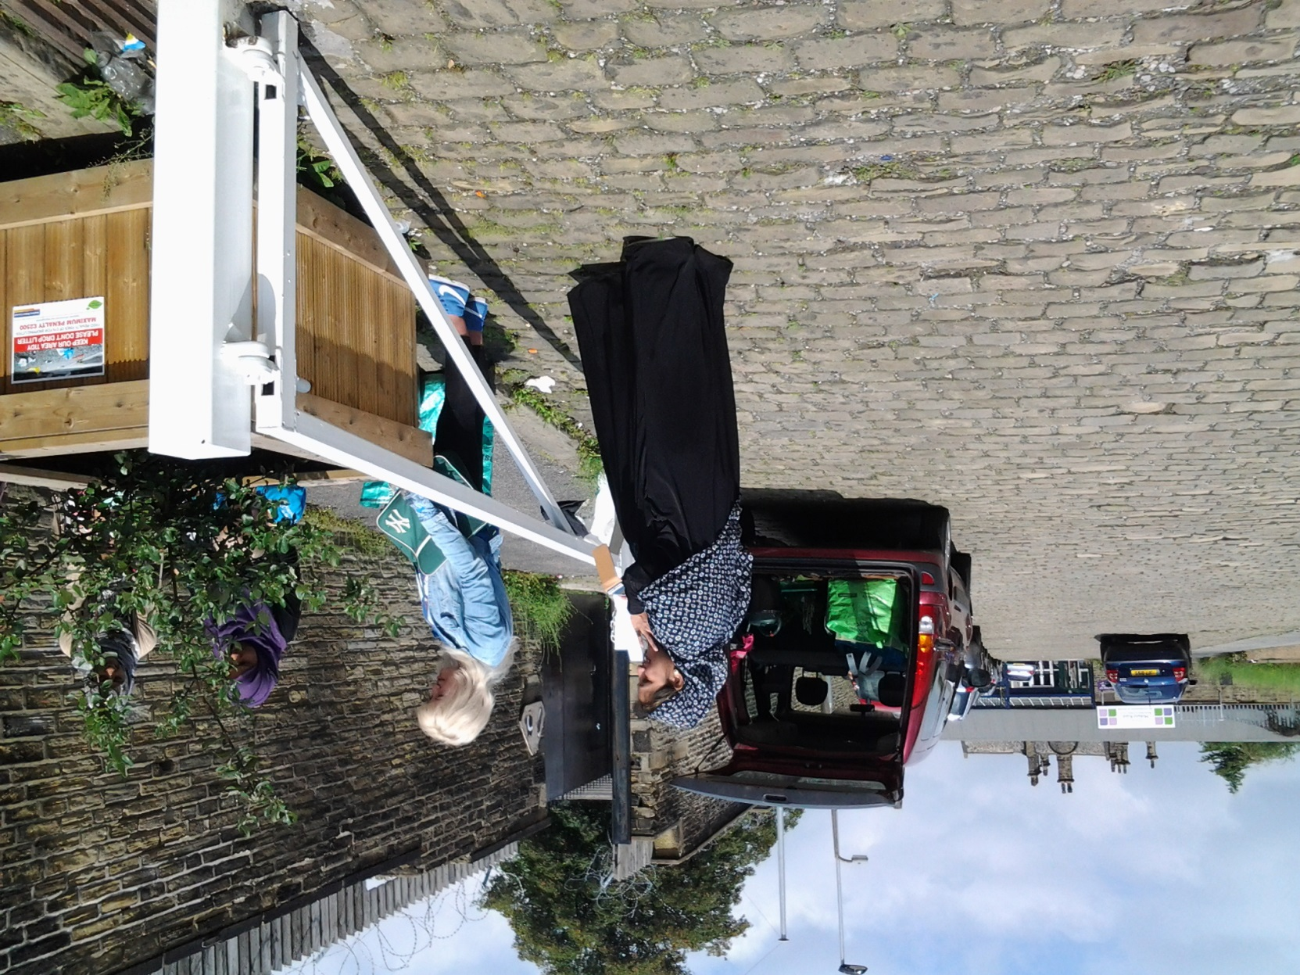

Slide 16
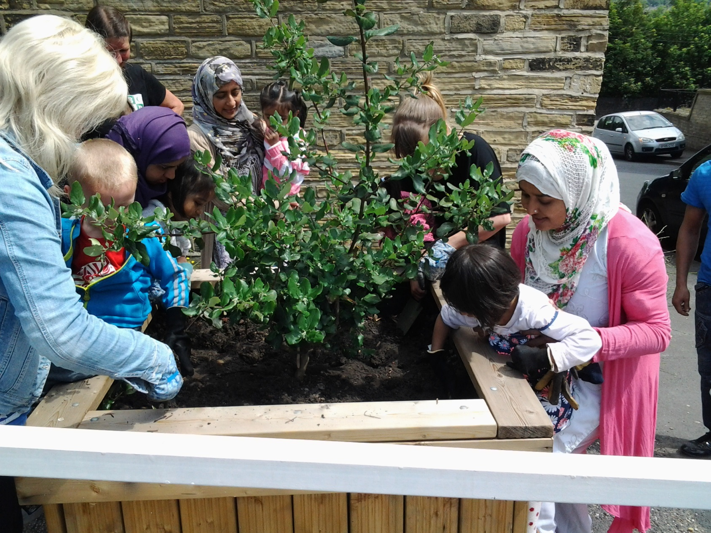

Slide 17
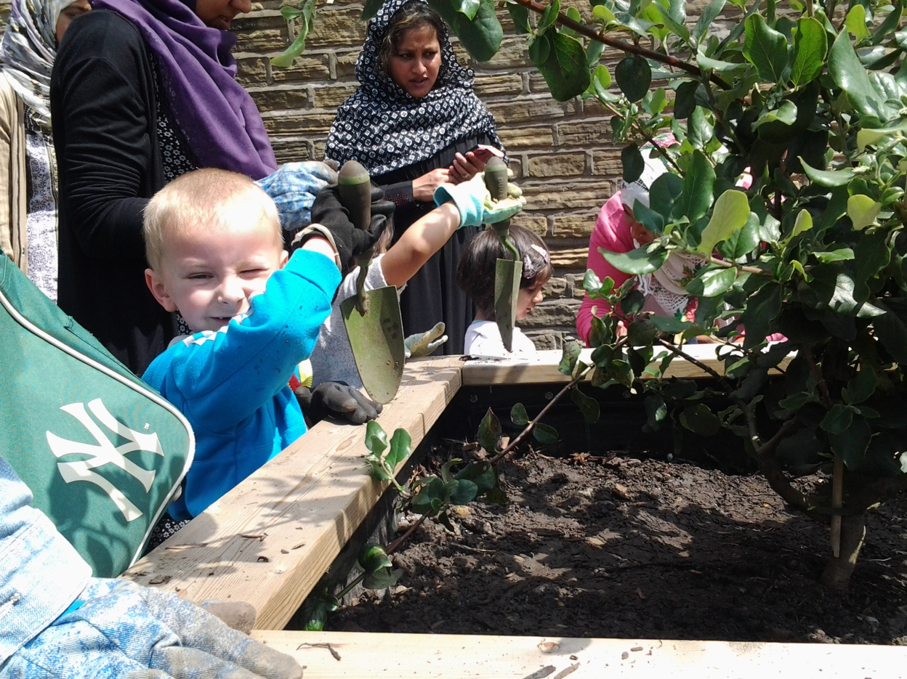

Slide 18
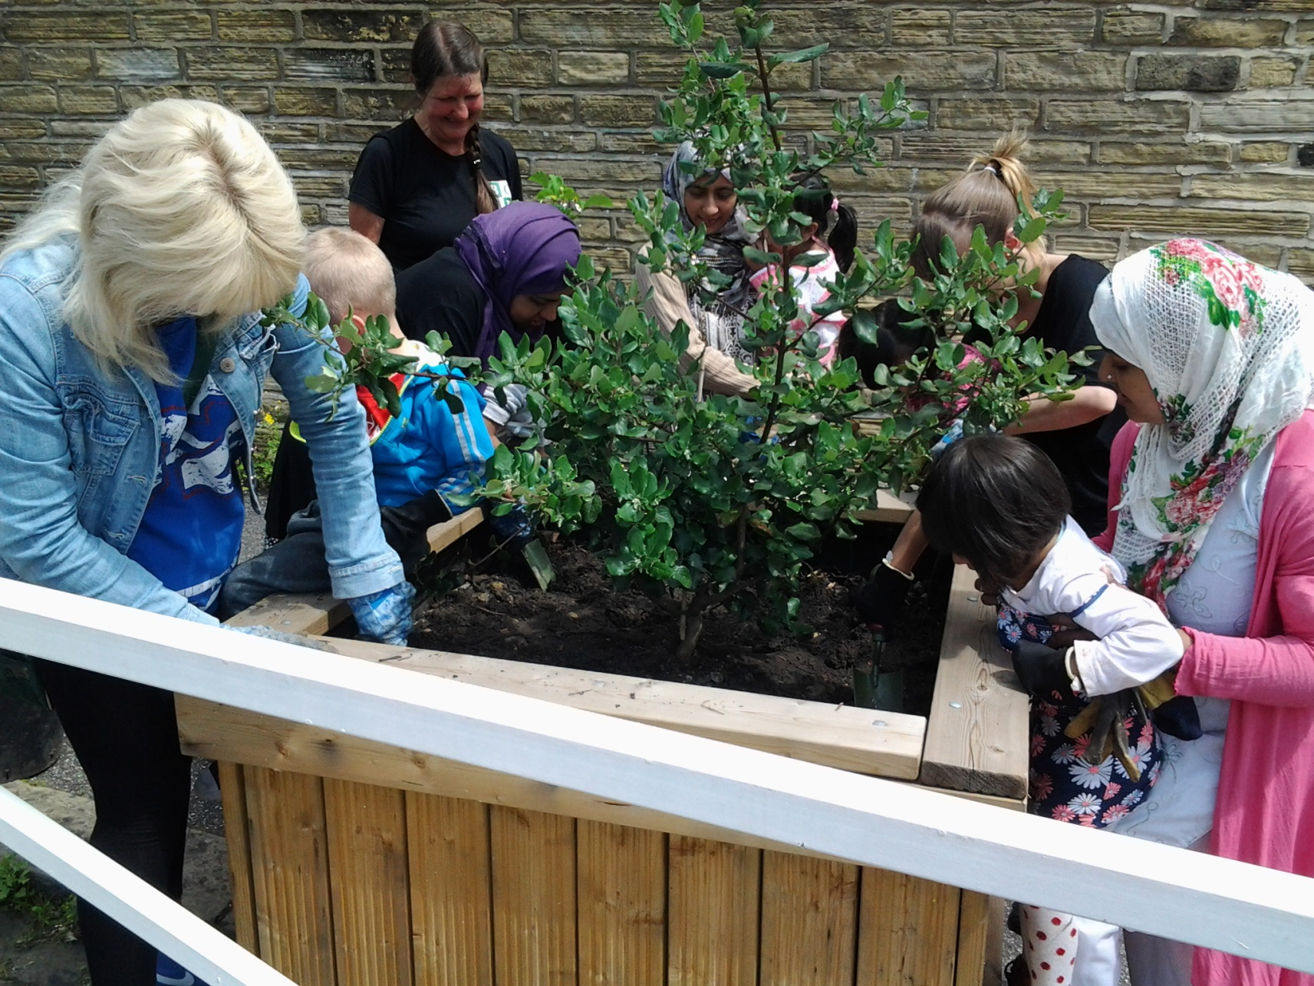

Slide 19
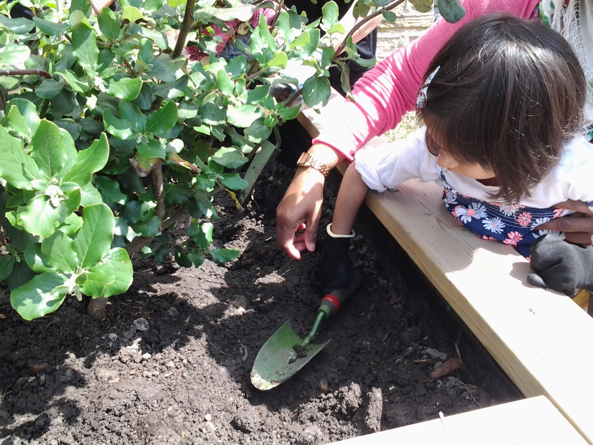

Slide 20
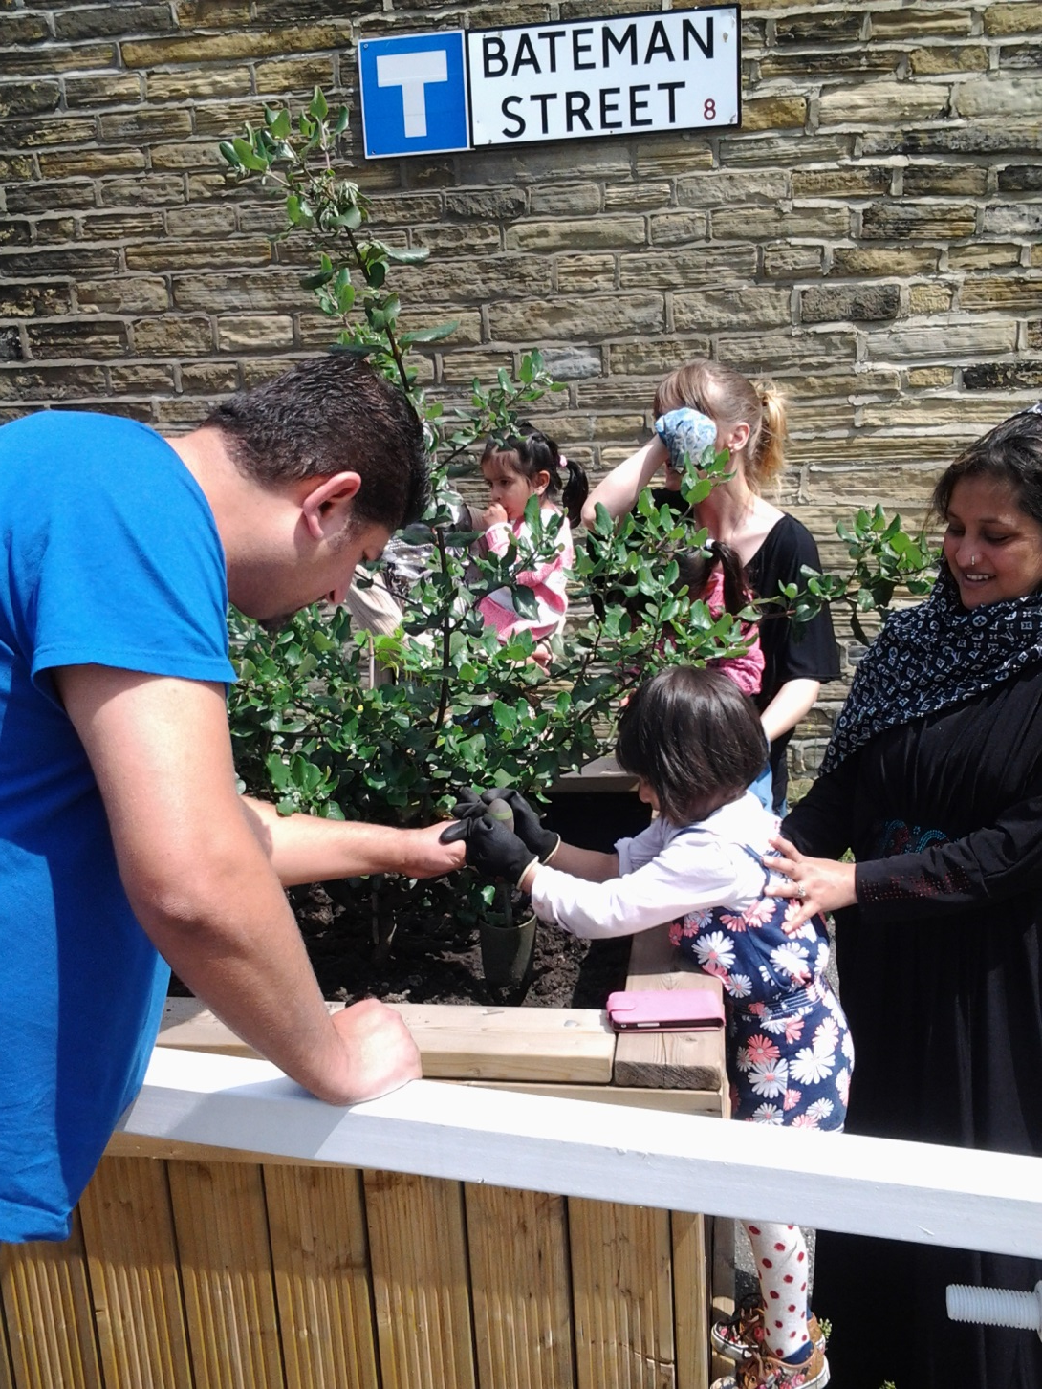

Slide 21
